Slide 1
Investigation of High-Capacity Digital Coherent Transceivers
Aimilios Christou, G&C College, ac2146

Slide 2
Introductory Slide
Give information about optical fibres (99% of all data)
Give context of the problem tackled

Slide 3
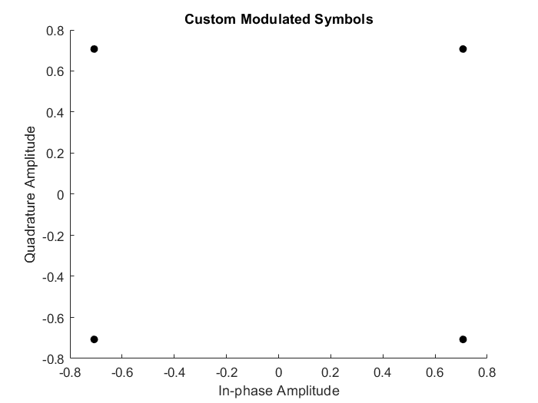
Modeling the transmitter
Began by sending a collection of 10000 random symbols
Modulation with gray-mapped QPSK (Matlab function)
Adding random noise in amplitude and phase
Implementation of my own QPSK function to better understand the concept
Demodulation with Matlab-provided functions
Wk 1

Slide 4
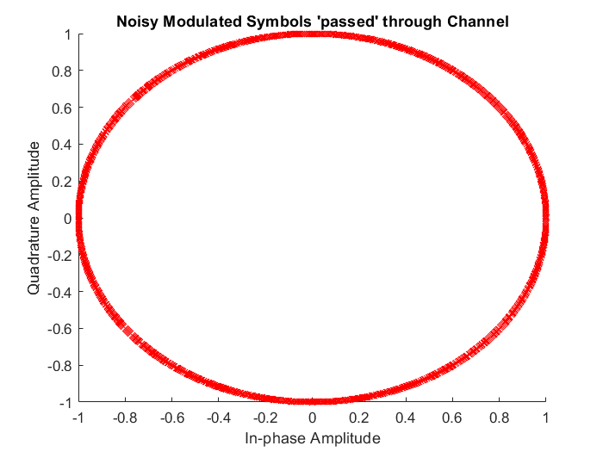
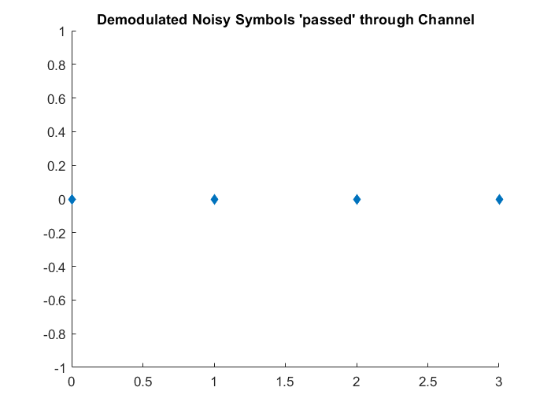
Noise and Demodulation

Slide 5
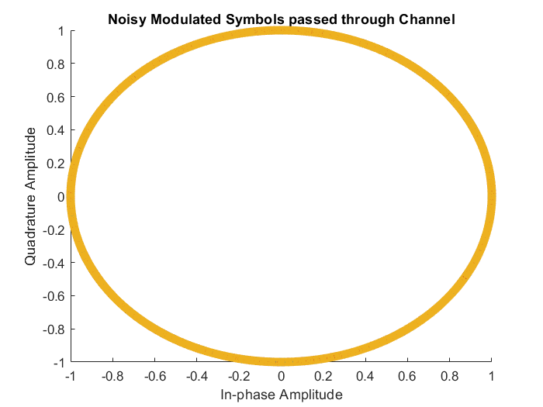
Random Walk Noise and Noise Sets
Created different sets of noise
Each set is an order of magnitude larger than the previous one
This noise only affects phase
The cumulative sum function was used to model the phase noise as a random walk process
Wk 2

Slide 6
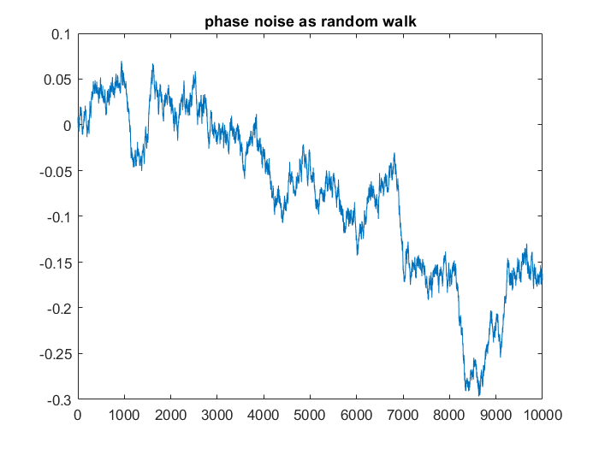
Random Walk Noise and Noise Sets

Slide 7
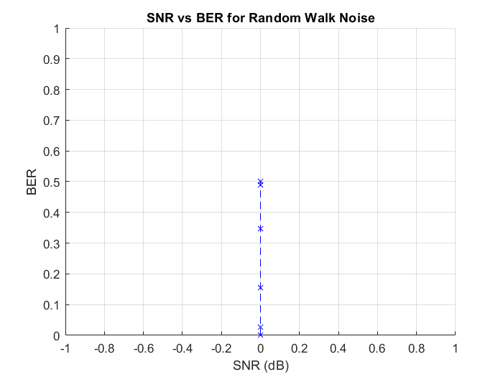
SNR and BER for Random Walk Noise
This noise only affects phase
Therefore the SNR is 1 regardless of the amount of phase noise added (0dB on graph)
Thus even though BER increases, the SNR cannot give us a measure of the level of noise added
Different technique needed, need to measure jitter
Wk 3

Slide 8
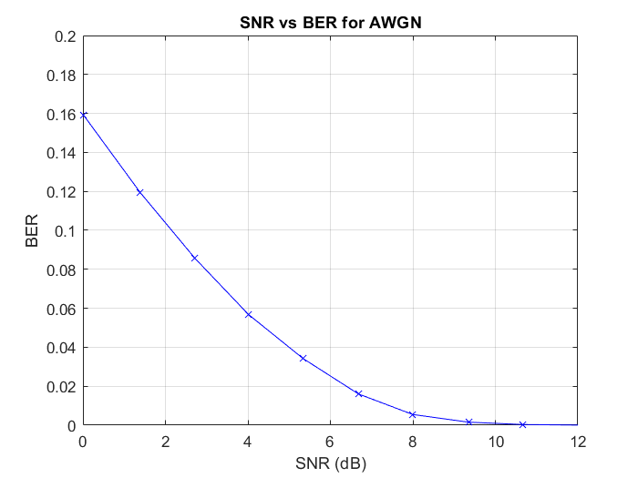
SNR and BER for AWGN
Repeating the transmission with AWGN noise gives the expected result.
Now two different noise models can be compared in further experiments
Created a known-symbol set instead of a random one for more control over the input

Slide 9
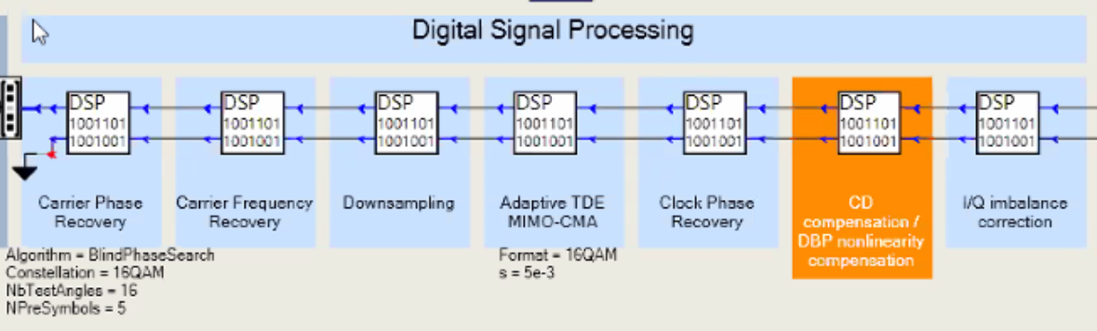
Working towards a transceiver model

Slide 10
Future goals
Continue implementation, iteratively including more components of simulated transceiver models until the industry standard is met
Work towards using synchronization, equalization and shaping algorithms (probabilistic shaping)
Explore physical constraints limiting the simulation

Slide 11
Timeline

